Slide 1


CMR TECHNICAL CAMPUS UGC AUTONOMOUS Accredited by NBA & NAAC with A Grade Approved by AICTE, New Delhi and Affiliated to JNTU,Hyderabad
DEPARTMENT OF COMPUTER SCIENCE AND ENGINEERING
MAJOR PROJECT
ON
AUTOMATIC DETECTION AND CLASSIFICATION OF EYE CATARACT IN FUNDUS IMAGES USING DEEP LEARNING TECHNIQUE
UNDER THE GUIDANCE OF
N. BHASKAR
PRESENTED BY
R. BHARGAVA CHARY (187R1A05A9)
S. PRATHYUSHA (187R1A05B6)
CH. NAGASAI TEJA (187R1A0568)
G. SHIRISHA (18C21A0553)

Slide 2
ABSTRACT
In this work we presented VGG-19 Algorithm, a deep neural network for automatically detecting cataracts in fundus images. We used the Ocular Disease Recognition Dataset (ODRD), which consists of 5000 fundus images acquired with three different fundus cameras. We have applied a VGG-19 architecture and trained the dataset ODRD and classified the results where we have achieved Accuracy of 96% and loss of 0.993.

Slide 3
EXISTING SYSTEM
Artificial Intelligence systems for cataract detection are based on global,deep and local features.
ResNet 50 is a model which has achieved 94% of accuracy and it has high number of model parameters and being computationally expensive.
DISADVANTAGES:-
It is an expensive procedure.
It is complex to identify cataract.
It has less number of accurate values.

Slide 4
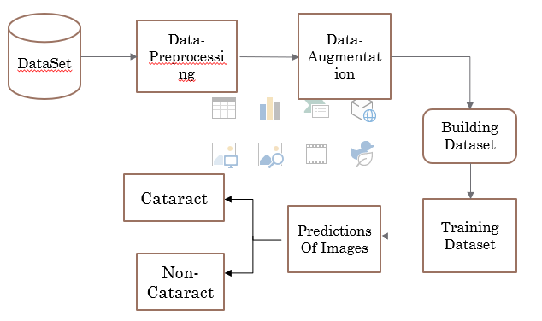
PROPOSED SYSTEM
We presented an automated cataract detection system namely VGG-19 based on deep learning and the dataset is rearranged,preprocessed and augumented to improve the dataset to feed deep network.
It classifies the patients into two groups: Cataract or Non-Cataract conditions.

Slide 5
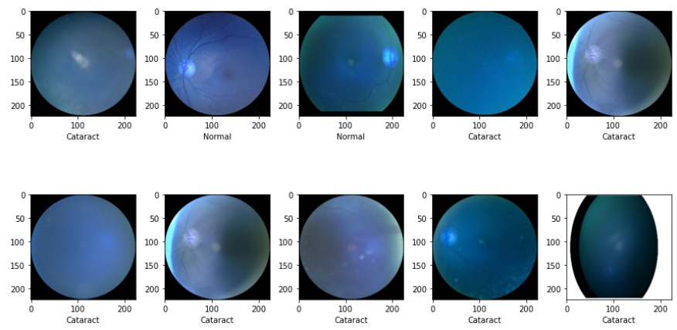
Through this we have extracted the cataract and normal information from the Dataset.
And Created a Dataset from Images

Slide 6
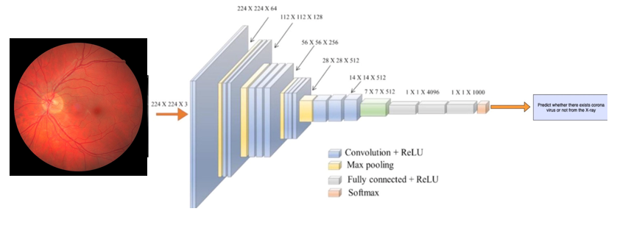
VGG-19 Architecture.
Advantages Of Proposed System:-
Reducing the number of parameters.
It has Low cost and High accuracy.
It requires less time.

Slide 7
Hardware Requirements
Ram:- 8GB or Higher
Processor:-Intel i5
Hard Disk:- 500GB

Slide 8
Software Requiremnts
Operating System:- Windows 10 or 11
Coding Language:- Python, Anaconda

Slide 9
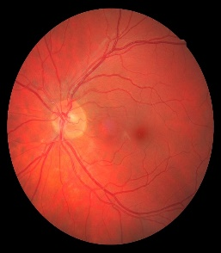
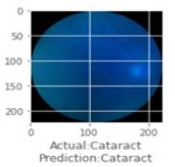
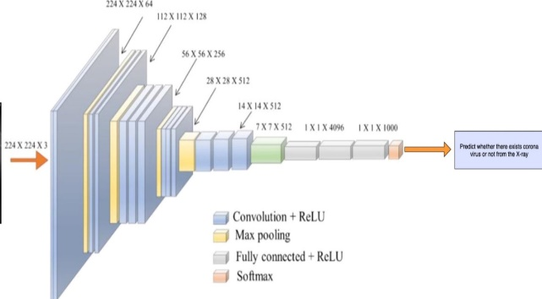
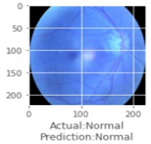
Project Architecture
INPUT
Data Preproce-ssing
Data Augment-atation
Cataract
Classifica-tion
Non-Cataract

Slide 10
Modules
Dataset:- The dataset consists of the fundus images that are extracted from Kaggle.com . Ocular Disease Recognition Dataset (ODRD, which consist of 5000 fundus images. Pre-Processing:- Preprocessing data is a common first step in deep learning to prepare raw data in a format that network can accept. In this unused data or noisy data is being removed from input data. Data Augmentation:-
Data augmentation is a process in which it rotates or rearrange or zoom in/out process is being done.
Classification:-
Classifying the fundus images into Cataract or Non cataract and also classifying that the cataract is at which level.
AUTOMATIC DETECTION AND CLASSIFICATION OF EYE CATARACT IN FUNDUS IMAGES USING DEEP LEARNING TECHNIQUE

Slide 11


Usecase Diagram
Gather DataSet
Prepare Dataset
Extract Data from dataset
Creating Dataset
User
Using CNN model
Prediction
AUTOMATIC DETECTION AND CLASSIFICATION OF EYE CATARACT IN FUNDUS IMAGES USING DEEP LEARNING TECHNIQUE

Slide 12
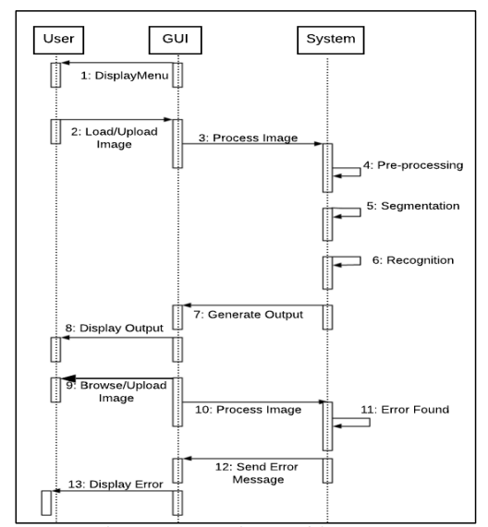
Sequence Diagram

Slide 13
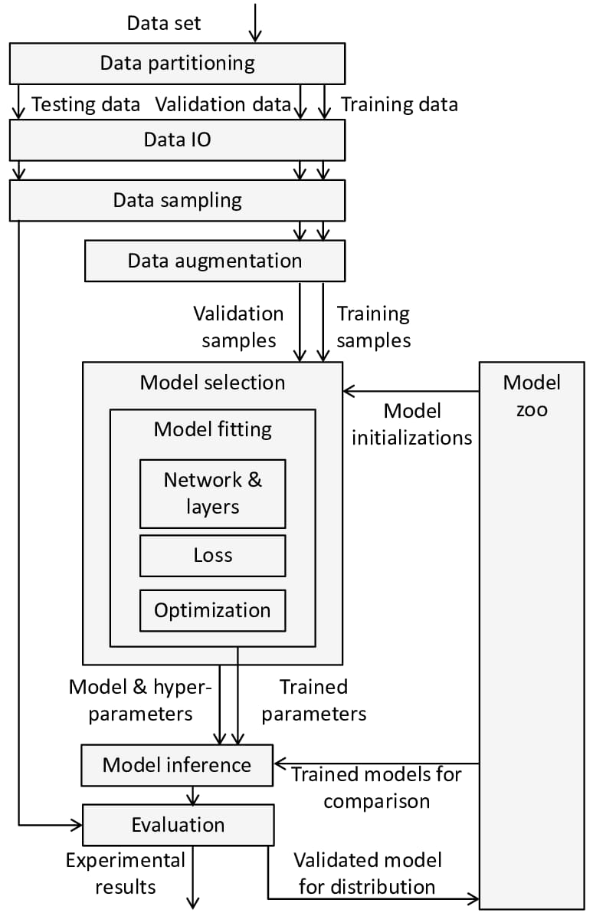
Data Flow Diagram

Slide 14
Sample Code
Import numpy as np # linear algebra
import pandas as pd # data processing, CSV file I/O import cv2 import random from tqdm
import tqdm
import ImageDataGenerator import os for dirname, _, filenames in os.walk(‘/Cataract’): for filename in filenames: print(os.path.join(dirname, filename))

Slide 15
Sample Code
df = pd.read_csv("C:/Users/bharg/C-Project/Evaluation_Set/Evaluation_Set/full_df.csv")
df.head(3)
def has_cataract(text):
if "cataract" in text:
return 1
else:
return 0
df["left_cataract"] = df["Left-Diagnostic Keywords"].apply(lambda x: has_cataract(x))
df["right_cataract"] = df["Right-Diagnostic Keywords"].apply(lambda x: has_cataract(x))
left_cataract = df.loc[(df.C ==1) & (df.left_cataract == 1)]["Left-Fundus"].values
left_cataract[:15]

Slide 16
from tensorflow.keras.preprocessing.image import load_img,img_to_array
dataset_dir = "C:/Users/bharg/Cataract"
image_size=224
labels = []
dataset = []
def create_dataset(image_category,label):
for img in tqdm(image_category):
image_path = os.path.join(dataset_dir,img)
try:
image = cv2.imread(image_path,cv2.IMREAD_COLOR)
image = cv2.resize(image,(image_size,image_size))

Slide 17
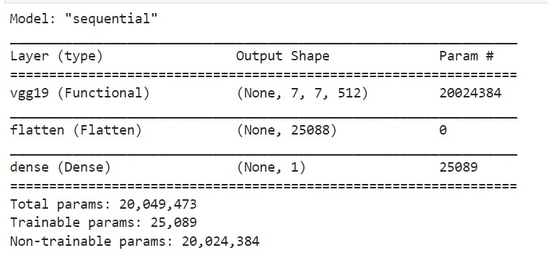
Results
Model:-

Slide 18
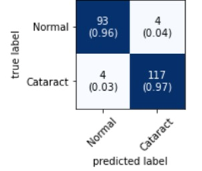
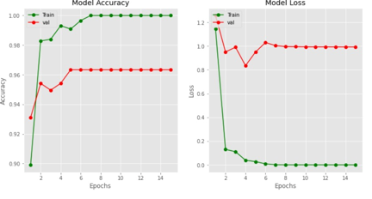
Results
True Lable and Predicted Lable
Learning Curve

Slide 19
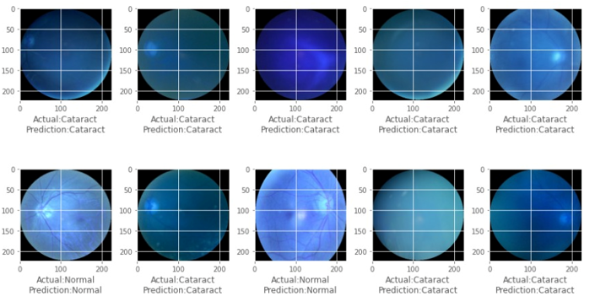
Prediction:-

Slide 20
Conclusion
Being highly accurate, cost- and time-efficient enabled the ophthalmologists to detect cataract disease timely and more precisely. The process is fast as compared to other techniques and provides an accurate value so that the level of eye cataract can be predicted and processed for further purpose.

Slide 21
THANK YOU

